Slide 1



Application of Bayesian methods
in effective field theory (EFT)
Dick Furnstahl
APS/DNP meeting, October, 2019
Special thanks to my BUQEYE collaborators!

Slide 2
Outline
Overview of Bayesian methods for EFT
Truncation errors and model checking
Aspects of EFT parameter estimation
Snapshots of Bayesian EFT applications
Take-away points and advertisements

Slide 3
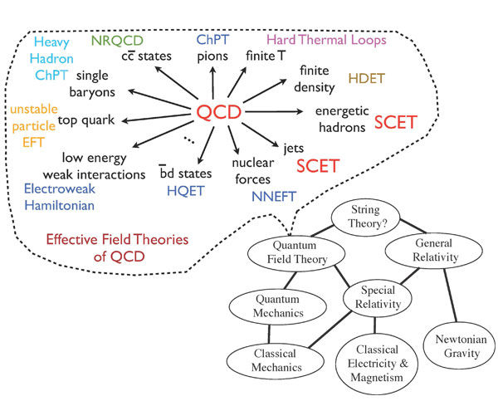
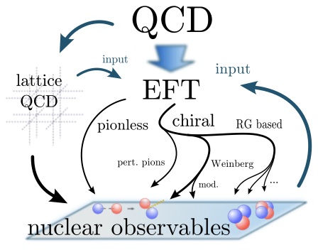
Quantum chromodynamics has many EFTs!
[From Sebastian König]
[From Iain Stewart]

Slide 4
Ingredients of EFTs that invite Bayesian statistics
Choice of degrees of freedom and organization (“power counting”)
Well-defined order-by-order construction used to predict observables ⇒ truncation error
Short distance physics is encoded in low-energy constants (LECs) that need to be fitted
Expectation is that observables improve as powers of a small parameter (e.g., ratios of scales) that may not be well determined
Need to validate the EFT and provide robust theory error bars
Bayesian approach: (almost) everything is a probability density function (pdf)!
Use rules of probability to manipulate
Marginalize over nuisance parameters

Slide 5


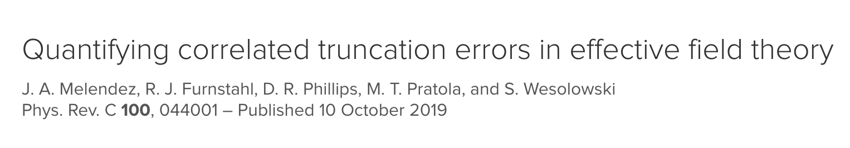
Example: chiral EFT expansion for NN observables
How do we apply Bayesian uncertainty quantification and model checking?

Slide 6
Example: chiral EFT expansion for NN observables
How do we apply Bayesian uncertainty quantification and model checking?
Melendez et al.,
PRC (2017)
[from R. Machleidt]

Slide 7
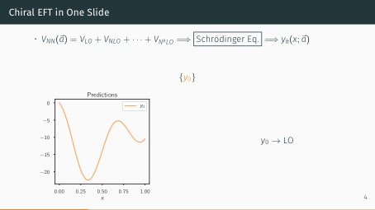
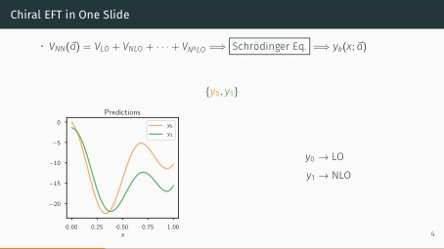
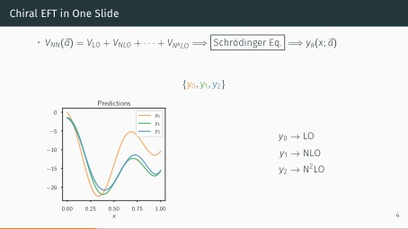
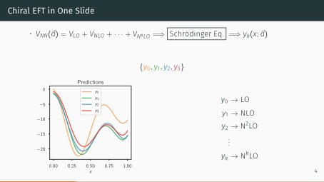
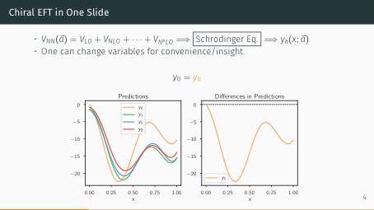
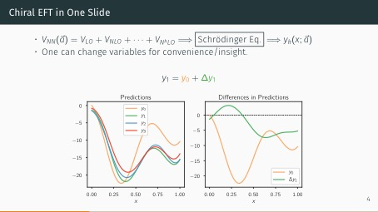
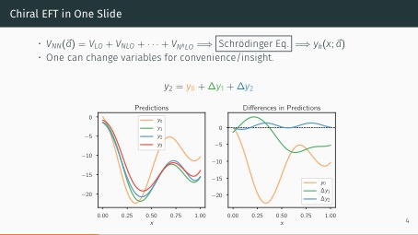
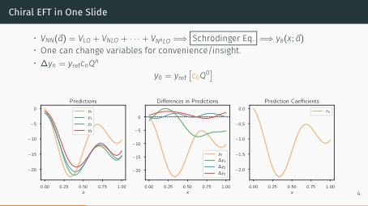
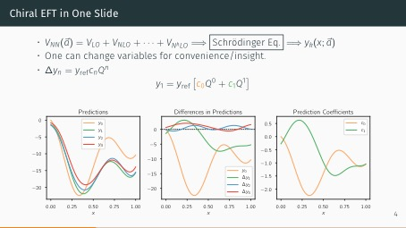
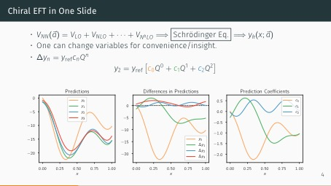
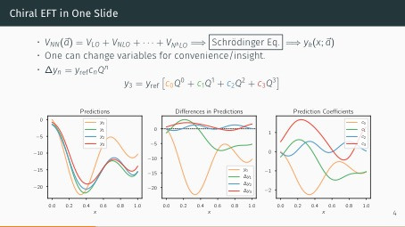
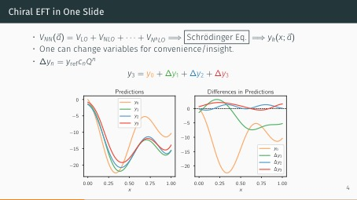
Generic example of EFT expansion (based on NN analysis)

Slide 8
Model discrepancy: EFT theory errors
Statistical model relating experiment and theory (all are functions of x):
Experimental discrepancy: usually normally distributed, can be correlated
Theoretical discrepancy: systematic, often difficult to quantify, often correlated
EFTs: specific expectations for theory error
Theory prediction at a certain order:
[Q < 1: expansion parameter (e.g., p/Λ_{b})]
Theory prediction at order k
Omitted terms from truncation
Bayesian: treat the c_{n}s as random variables, depending on x; train on c_{n} for n ≤ k
Notes:
\newcommand{\bm}[1]{\boldsymbol{#1}}
\newcommand{\genobs}{\bm{y}}
\genobs_{\text{exp}} = \genobs_{\text{th}} + \delta \genobs_{\text{th}} + \delta \genobs_{\text{exp}}
\genobs_k = \genobs_{\text{ref}} \sum_{n=0}^k c_n Q^n

Slide 9
Gaussian process model of the coefficients

Slide 10
Model checking: Does our model refer to reality?
Use metric to measure GP-ness to test model: Mahalanobis distance
This is what success looks like!
Melendez et al., PRC (2019)

Slide 11
Model checking: Does our model refer to reality?
Use metric to measure GP-ness to test assumption: Mahalanobis distance
This is what failure looks like!
Melendez et al., PRC (2019)

Slide 12
Model checking: Does our model refer to reality?
EKM semi-local NN potential (R = 0.9 fm). Results for total np cross section.
Ok for low orders but a problem at the highest order.
Melendez et al., PRC (2019)

Slide 13
Model checking: Do our error bands have statistical meaning?
Credible interval diagnostic
Melendez et al., PRC (2019)

Slide 14
What is the breakdown scale of our EFT?
Melendez et al., in preparation (2019)

Slide 15
Symmetry energy in infinite matter (preliminary!)
Christian Drischler, Jordan Melendez, et al., in preparation
NN potential: Entem-Machleidt-Nosyk (450 MeV) with fitted 3N LECs
Many interesting questions to investigate and comparisons to make!

Slide 16
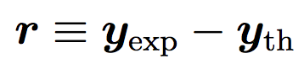
Parameter estimation: Exploring projected posteriors
First without the model discrepancy (theory error) term:
Consider high-enough order so that truncation error is small
Regular least-squares (𝜒²) likelihood times Gaussian prior for natural LECs:
Residual:
Discourages large LECs (naturalness)
Notes:
\newcommand{\bm}[1]{\boldsymbol{#1}}
\newcommand{\genobs}{\bm{y}}
\newcommand{\pr}{\text{pr}}
\newcommand{\avec}{\vec{a}}
\pr(\avec_k|\genobs_{\text{exp}},\Sigma_{\text{exp}}) \propto \pr(\genobs_{\text{exp}}|\avec_k, \Sigma_{\text{exp}})\ \pr(\avec_k)
\propto e^{-\resvec^T\Sigma_{\text{exp}}^{-1} \resvec} \times e^{-(\avec_k)^2/2\abar^2}

Slide 17
Projected posteriors as a diagnostic tool
Projected posteriors give:
info on correlations
“best” parameter values
indication of normality
Uncorrelated and Gaussian
Also: Comparison to EKM’s values from optimization
(need not match!)
3P0 channel at N3LO
np sector

Slide 18
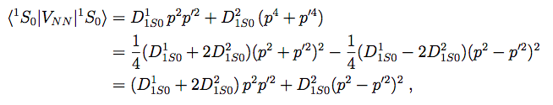
Projected posteriors as a diagnostic tool
1S0 channel at N3LO
np sector
Irregular structure of posterior
Nothing necessarily wrong, but a clue
Here: a physics issue actually explains the distorted structure
Parameter redundancy at N3LO, an operator can be eliminated
True in 3S1-3D1 channel as well
Wesolowski et al., J. Phys. G (2019)

Slide 19
Projected posteriors as a diagnostic tool
1S0 channel at N3LO
np sector
Set to 0 and use only 3 parameters
Description of data still good (and potential softer)
Reinert et al., EPJA (2018) improved potential
Wesolowski et al., J. Phys. G (2019)

Slide 20
Effect of the prior with less data
Wesolowski et al., J. Phys. G (2019)
Repeat same problem, vary givens
Increase prior width
Less data, prior needed to avoid overfitting
Increase range of data, prior has less influence
Increase E_{max} (more data at higher energy)

Slide 21
Parameter estimation including truncation errors
We can put a prior on the unknown higher-order coefficients:
Just a sum of Gaussian random variables using this prior (which we have validated)
Two extreme assumptions about correlations
1. Theory error at each kinematic point (Q) is completely uncorrelated:
2. Theory error at each kinematic point (Q) is fully correlated, with same coefficients:

Slide 22
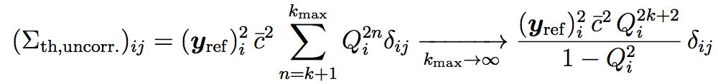
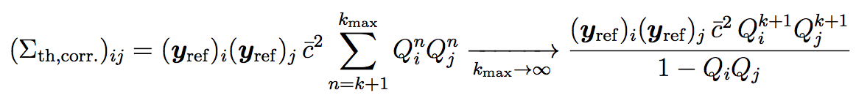
Parameter estimation including truncation errors
Full posterior pdf including theory error:
Covariance matrix for assuming uncorrelated Q points:
Covariance matrix assuming fully correlated Q points:
Wesolowski et al., J. Phys. G (2019)

Slide 23
Effect of including truncation errors
Use partial-wave cross sections extracted from PWA phase shifts
Uncorrelated assumption
Correlated assumption
Wesolowski et al., J. Phys. G (2019)

Slide 24
Effect of including truncation errors in parameter estimation
If effects of higher-order operators are absorbed by including theory errors, LEC extractions should be independent of E_{max}, the highest-energy datum used:
Uncorrelated assumption
Correlated assumption
Wesolowski et al., J. Phys. G (2019)

Slide 25
But won’t the Bayesian sampling calculations take too long?
arXiv:1909.08446

Slide 26
But won’t all of these Bayesian sampling calculations take too long?
arXiv: 1910.02922
“We have to use (16 + 1) · 216 = 1,114,112 quasi MC samples to extract statistically significant main and total effects of the energy and radius for all LECs. With SP-CC(64) this took about 1 hour on a standard laptop, while an equivalent set of exact CCSD computations would require 20 years."

Slide 27
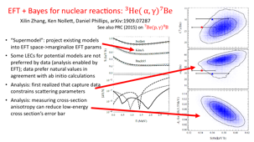
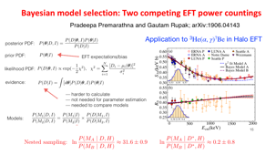
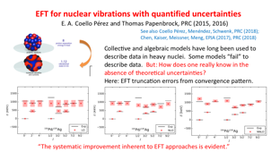
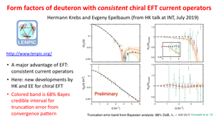


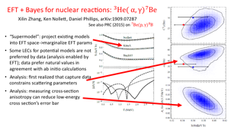

Snapshots of Bayesian methods for EFT

Slide 28
Form factors of deuteron with consistent chiral EFT current operators
Hermann Krebs and Evgeny Epelbaum (from HK talk at INT, July 2019)
http://www.lenpic.org/
A major advantage of EFT: consistent current operators
Here: new developments by HK and EE for chiral EFT
Colored band is 68% Bayes credible interval for truncation error from convergence pattern

Slide 29
EFT for nuclear vibrations with quantified uncertainties
E. A. Coello Pérez and Thomas Papenbrock, PRC (2015, 2016)
See also Coello Pérez, Menéndez, Schwenk, PRC (2018);
Chen, Kaiser, Meissner, Meng, EPJA (2017), PRC (2018)
Collective and algebraic models have long been used to describe data in heavy nuclei. Some models “fail” to describe data. But: How does one really know in the absence of theoretical uncertainties?
Here: EFT truncation errors from convergence pattern.
“The systematic improvement inherent to EFT approaches is evident.”

Slide 30
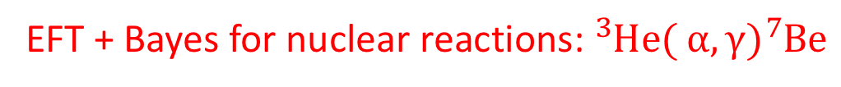
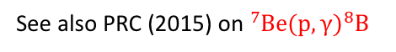
EFT + Bayes for nuclear reactions: ${}_{ }^{3}{He({}_{ }^{ }α,γ){}_{ }^{7}{Be}}$
Xilin Zhang, Ken Nollett, Daniel Phillips, arXiv:1909.07287
See also PRC (2015) on ${}_{ }^{7}{Be(p,γ){}_{ }^{8}B}$
“Supermodel”: project existing models into EFT space->marginalize EFT params
Some LECs for potential models are not preferred by data (analysis enabled by EFT); data prefer natural values in agreement with ab initio calculations
Analysis: first realized that capture data constrains scattering parameters
Analysis: measuring cross-section anisotropy can reduce low-energy cross section’s error bar

Slide 31
Bayesian model selection: Two competing EFT power countings
Pradeepa Premarathna and Gautam Rupak; arXiv:1906.04143
Application to ³He(α, γ)⁷Be in Halo EFT

Slide 32
Take-away Points
Bayesian statistics is an ideal framework for EFT uncertainty quantification.
Theory discrepancy model based on convergence pattern and naturalness priors; GP truncation error model accounts for correlations; 𝚲_{b} estimates.
Model checking is an essential part of Bayesian UQ.
Parameter estimation with LEC priors and model discrepancy minimizes dependence on how much data is used; posterior diagnostics point to physics issues.
Need to sample for parameter estimation and the propagation of uncertainties: Eigenvector continuation is very promising solution to computational load!
Model selection is a frontier for EFT Bayesian statistics.

Slide 33
BUQEYE Collaboration (“Bayesian Uncertainty Quantification: Errors for Your EFT”)
https://buqeye.github.io
gsum: A Bayesian model of series convergence using Gaussian sums.
The gsum package provides convenient classes that allow one to analyze the convergence pattern of Effective Field Theory (EFT) observables. Specifically, this is a conjugacy-based implementation of the statistical model described in arXiv:1904.10581.
Correlated truncation errors in effective field theory: The code behind the manuscript. This Jupyter notebook provides the Python code to reproduce all of the plots from Melendez et al., Phys. Rev. C 100, 044001 (2019), arXiv:1904.10581.

Slide 34
Journal of Physics G Special Focus Issue
Focus on further enhancing the interaction between nuclear experiment and theory through information and statistics (ISNET 2.0)
Guest Editors
Dick Furnstahl Ohio State University
David Ireland University of Glasgow
Daniel Philips Ohio University
“Following on from the hugely successful first edition in 2015, Journal of Physics G: Nuclear and Particle Physics is delighted to announce a second focus issue inspired by the ISNET workshops (Information and Statistics in Nuclear Experiment and Theory.”
Two articles already published!
Please consider contributing!
https://iopscience.iop.org/journal/0954-3899/page/ISNET2

Slide 35
TALENT: Training in Advanced Low-Energy Nuclear Theory
The TALENT initiative aims at providing advanced training to graduate students and young researchers in low-energy nuclear theory. TALENT offers intensive three-week courses on a rotating set of topics.
Bayes2019. Learning from Data: Bayesian Methods and Machine Learning,
at the University of York, UK, June 10-28, 2019. See the github site for many Jupyter notebooks and lecture notes: https://nucleartalent.github.io/Bayes2019/
TALENT courses scheduled for 2020 (see http://nucleartalent.org for more info):
Atomic Nuclei as Open Quantum Systems: Unifying Nuclear Structure and Reactions will be held at the INT in Seattle, WA from June 22 to July 10, 2020. Contact: Christian Forssén (christian.forssen@chalmers.se).
Density Functional Theory and Self-Consistent Methods will be held at LBNL, in Berkeley, CA. The (tentative) dates are July 6 to July 24, 2020. Contact: Nicolas Schunck (schunck1@llnl.gov).
Machine Learning and Data Analysis for Nuclear Physics will be held at the ECT* in Trento, Italy. The (tentative) dates are June 29 to July 17, 2020. Contact: Morten Hjorth-Jensen (hjensen@msu.edu).

